Slide 1

HRI PROJECT
BY: DENNY BOBY NIHAL SUNEEL NAVALE

Slide 2
Integrating Robots with Speech Recognition to Perform Tasks
Github Link: https://github.com/dennyboby/social_robot_navigation

Slide 3
Problem Description
P: A hospital is a place where every second of a patient matters. There are moments where the patients are un-supervised and these moments may end-up in life threatening scenarios. What do we do ?
A: Designing a social robot which can recognize and understand human speech and perform predefined tasks. The robot is set in an hospital environment and assists nurses, doctors and other staff of the hospital. The task can be notifying the nurse station of the location of the patient, and the task can also be transporting medicine and other equipment.

Slide 4
Application Impact
The applications of Speech Assisted robots are immense. Such robots will be more trusted among humans and will be able to bridge the gap between human and robot communication. This technology will help integrate robots into the human lives better, the robots can then be placed to assist professionals in the Hospitality Industry, Education Industry, Medical Industry and can also become a part of the family and help with early-child education, therapy, assistance of the elderly and also provide home security.
The sky's the limit when Humans and Robots work together !

Slide 5
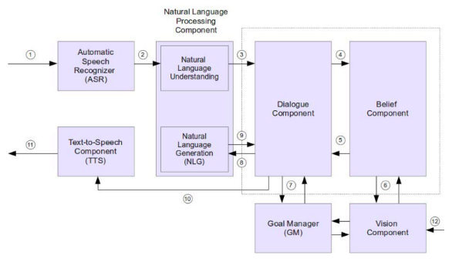
Related Work
Enabling Robots to Understand Indirect Speech Acts in Task-Based Interactions
Gordon Briggs, Tom Williams and Matthias Scheutz (2017),
Humans tend to phrase their directives to robots indirectly, especially in a social context.
Introduced a dialog based mechanism to infer intended meanings from such indirect speech and demonstrated that these mechanisms can handle all indirect speech acts in their experiment as well as in other common forms of request.

Slide 6
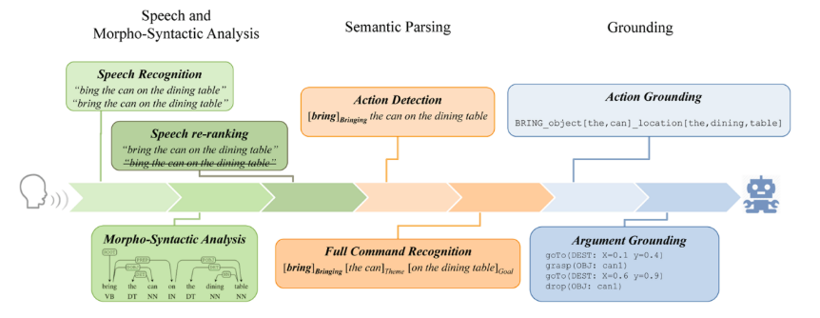
Related Work
Structured learning for spoken language understanding in human-robot interaction
Emanuele Bastianelli, Giuseppe Castellucci, Danilo Croce, Roberto Basili and Daniele Nardi (2017)
Design of natural language interfaces for human robot interaction, to translate spoken commands into computational structures that enable the robot to execute the intended request.
The proposed solution is achieved by combining a general theory of language semantics with the state-of-the-art methods for robust spoken language understanding. Their results show that their processing chain, trained with generic resources, provides a solid baseline for command understanding in a service robot domain.

Slide 7
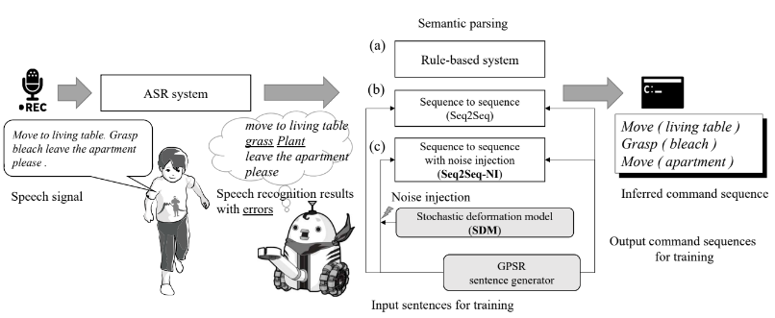
Related Work
Robust Understanding of Robot-directed Speech Commands using Sequence to Sequence with Noise Injection
Tada, Y., Hagiwara, Y., Tanaka, H., & Taniguchi, T. (2020)
New method that enables a service robot to understand spoken commands in a robust manner using off-the-shelf automatic speech recognition (ASR) systems and an encoder-decoder neural network (sequence to sequence) with noise injection.
The noise is injected into phoneme sequences during the train phase of encoder-decoder neural network based semantic parsing systems They demonstrate that the use of neural networks with a noise injection can mitigate the negative effects of speech recognition errors in understanding robot-directed speech commands.

Slide 8
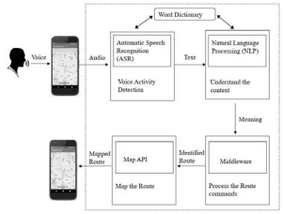
Related Work
Road Navigation System Using Automatic Speech Recognition (ASR) And Natural Language Processing (NLP)
Withanage, P., Liyanage, T., Deeyakaduwe, N., Dias, E., & Thelijjagoda, S. (2018)
Use ASR and natural language processing for road navigation. They propose a user centric roadmap navigation application called “Direct Me”.
The approach of generating the user preferred route, the system will first convert the audio streams into texts through ASR using Pocket Sphinx Library, followed by NLP utilizing Stanford CoreNLP framework to retrieve the navigation-associated information and process the route in the Map using Google Map API.

Slide 9
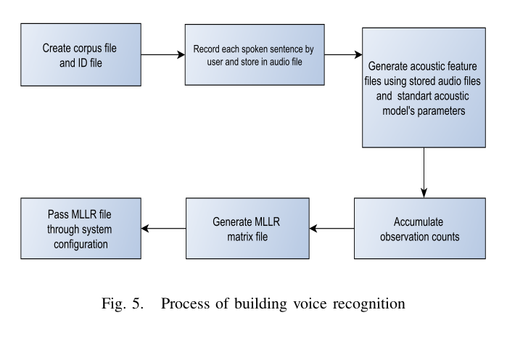
Related Work
Implementation and Testing of Voice Control in a Mobile Robot for Navigation
Sharan, S., Nguyen, T. Q., Nauth, P., & Araujo, R. (2019)
A voice control software system is integrated with the SLAM algorithm available in robotic operating system (ROS) and implemented to a mobile system of a robot “ROSWITHA”.
This paper also expresses the different ways of controlling the robot by developing a graphical user interface (GUI) with different controlling tabs.
The experiment and test is performed real time in environments with different speakers to analyze the accuracy of the system.

Slide 10
Proposed Method
The method flow is as follows:
Speech recognition: The tools used will be one among IBM Watson, Google Speech Recognition, Picovoice module to convert speech to text.
Semantic Analysis: We have tested NLP tools like IBM Watson, Google Cloud NLP API, NLTK, Picovoice Rhino to extract keywords and features from the text from ASR model and develop a model to recognize Intent. We are using Picovoice Rhino.
Speech Synthesis: We plan on using pyttsx3 or similar text to speech conversion library in python to generate speech.
Navigation: In this the plan is to use the recognised navigation command from human speech to give a point A to B task or from point A to B then C task to the robot. We are using a PID controller to follow a straight path segment and rotation to align to next path segment.
Notes:
Nihal

Slide 11
Proposed Method
SPEECH RECOGNITION
SPEECH ANALYSIS
SEMANTIC PARSING
COMMAND RECOGNITION
R
O
S
TASK
<--------------------SEMANTIC ANALYSIS----------------------->
Semantic analysis of natural language content starts by reading all of the words in content to capture the real meaning of any text. It identifies the text elements and assigns them to their logical and grammatical role. It analyzes context in the surrounding text and it analyzes the text structure to accurately disambiguate the proper meaning of words that have more than one definition.
Notes:
Nihal

Slide 12
Experiment
Tasks:
Understand human intent when the speech is command-like and conversational depending upon the perceived intent the robot must perform accordingly.
When a speech is provided containing ambiguity of intent the robot must communicate and ask for clear commands or ask further questions to clear ambiguity.
Evaluation Metrics:
Accuracy of the robot to understand different accents of humans regardless of age and gender.
Statistics of the number of times a person has to repeat speech to execute the right command.
Accuracy of intent
User rating on collaboration with the robot and the effort in communication.
Performance analysis of Speech Recognition, Semantic Analysis & Speech synthesis.
Notes:
Denny

Slide 13
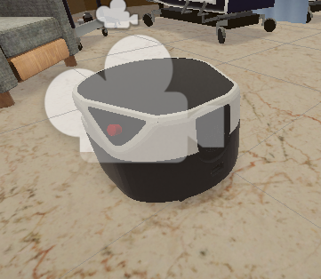
Devices
Simulation: Unity Engine
Robot: Nursing Robot (Freight)
Tools: ROS, ASR (Picovoice) & NLP (Picovoice).
Notes:
Denny

Slide 14
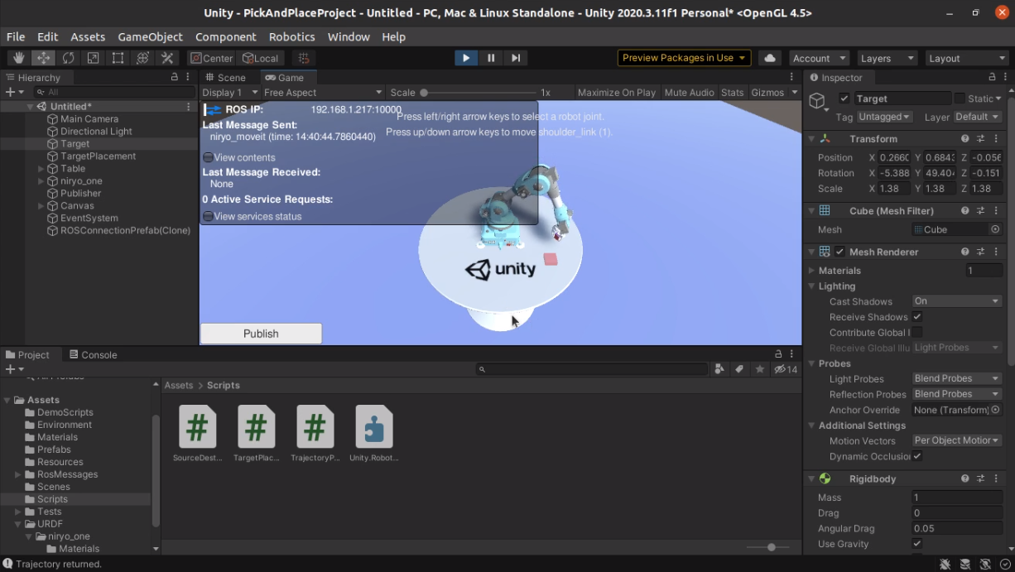
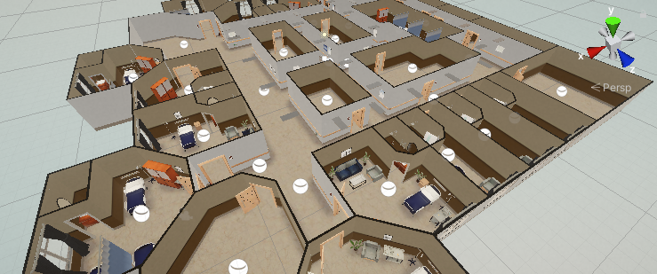
Result
Simulation
Task done:
Executed Pick and Place Tutorial by Unity-Robotics-Hub.
Setup Nursing Robot simulation
Added Freight robot to simulation
Visualized robot in Rviz
Learning:
Unity installation
Running Unity and folder structure of Unity project.
Different components in Unity, and how to use them.
Notes:
Denny

Slide 15
Result
2. Speech
Task done:
Speech recognition: Tested Google ASR, IBM Watson and Picovoice to detect speech.
We are using Picovoice because of its high word acceptance rate of 97.6% in noisy Environment.
We are using Picovoice Rhino console to develop the NLP model which gives us the intent of the speech.
Collected dataset to train Picovoice Rhino model. (Link)
Created a script that listens to wake word “Jarvis”, listens to the speech command, generates intent message using the trained model and publishes the navigation goal.
Learning:
Working of Speech Recognition, Natural Language Processing, Picovoice Console, Coding in Python.
Notes:
Nihal

Slide 16
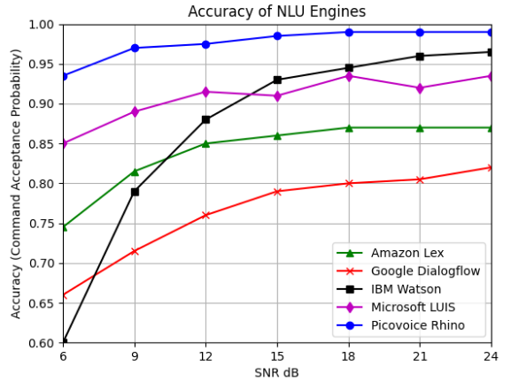
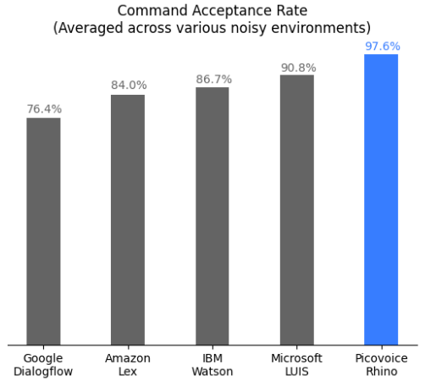
Picovoice

Slide 17
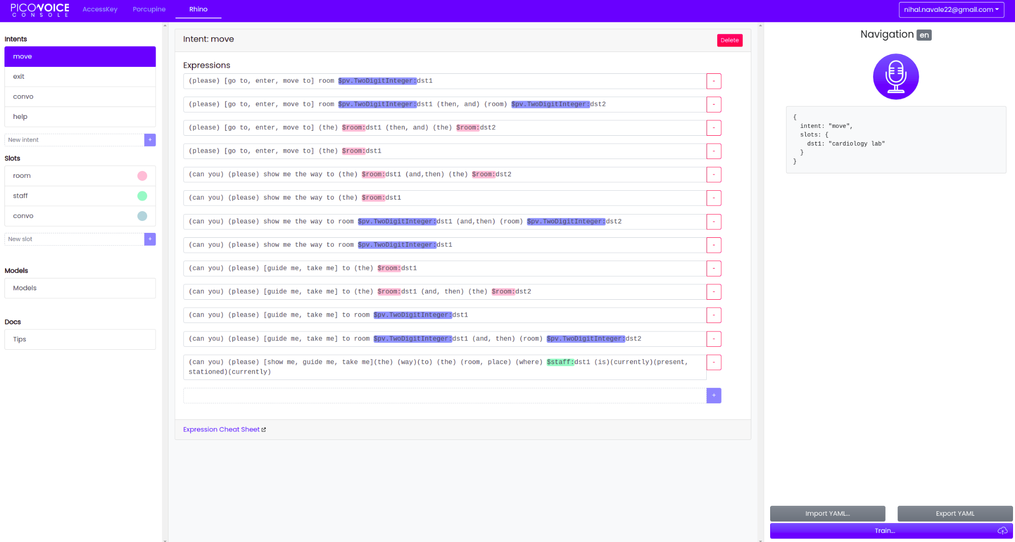
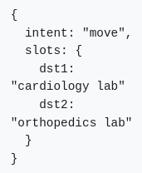
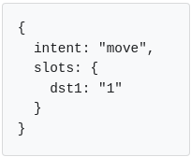
Working of Picovoice

Slide 18
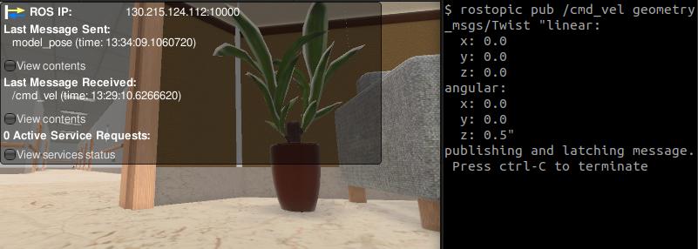
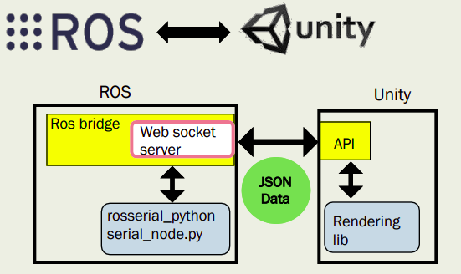
Result
3. Navigation
Task done:
Setup interface between ROS and Unity
Published to /cmd_vel topic via terminal and controlled the robot in Unity.
Created a script that receives the navigation goal and moves the robot to desired location.
Learning:
Working and communication between ROS and Unity
Add plugin in Unity to communicate with ROS
Notes:
Denny

Slide 19
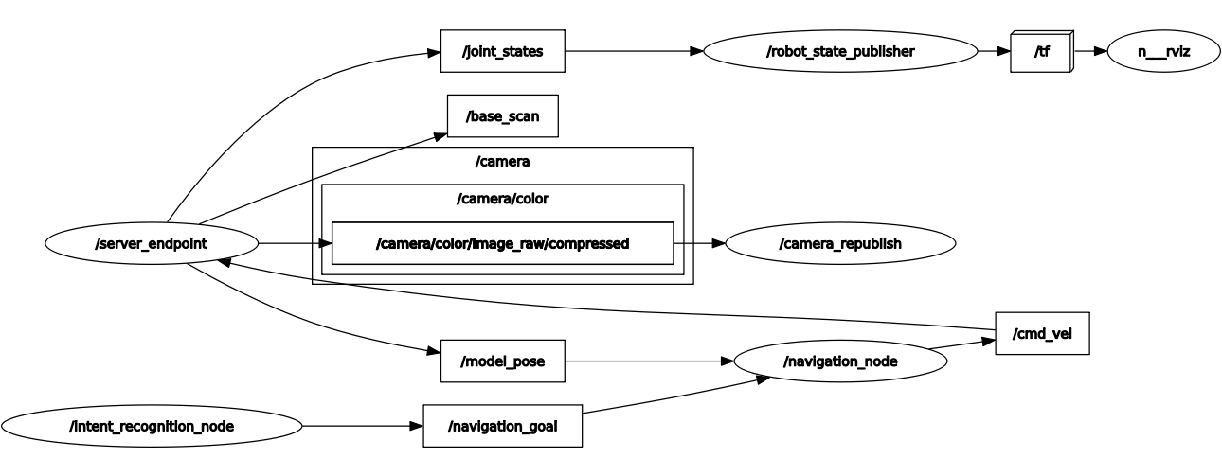
Result
RQT_GRAPH
Notes:
Denny

Slide 20
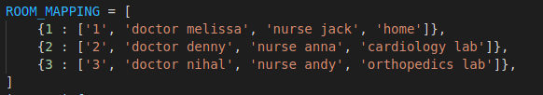
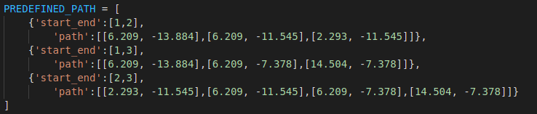
Mapping

Slide 21
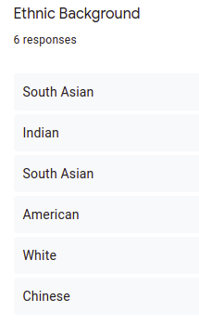
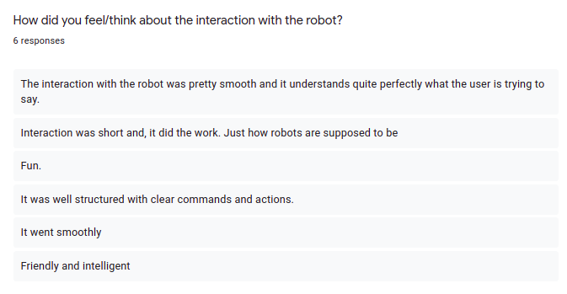
User Study
Notes:
Denny

Slide 22
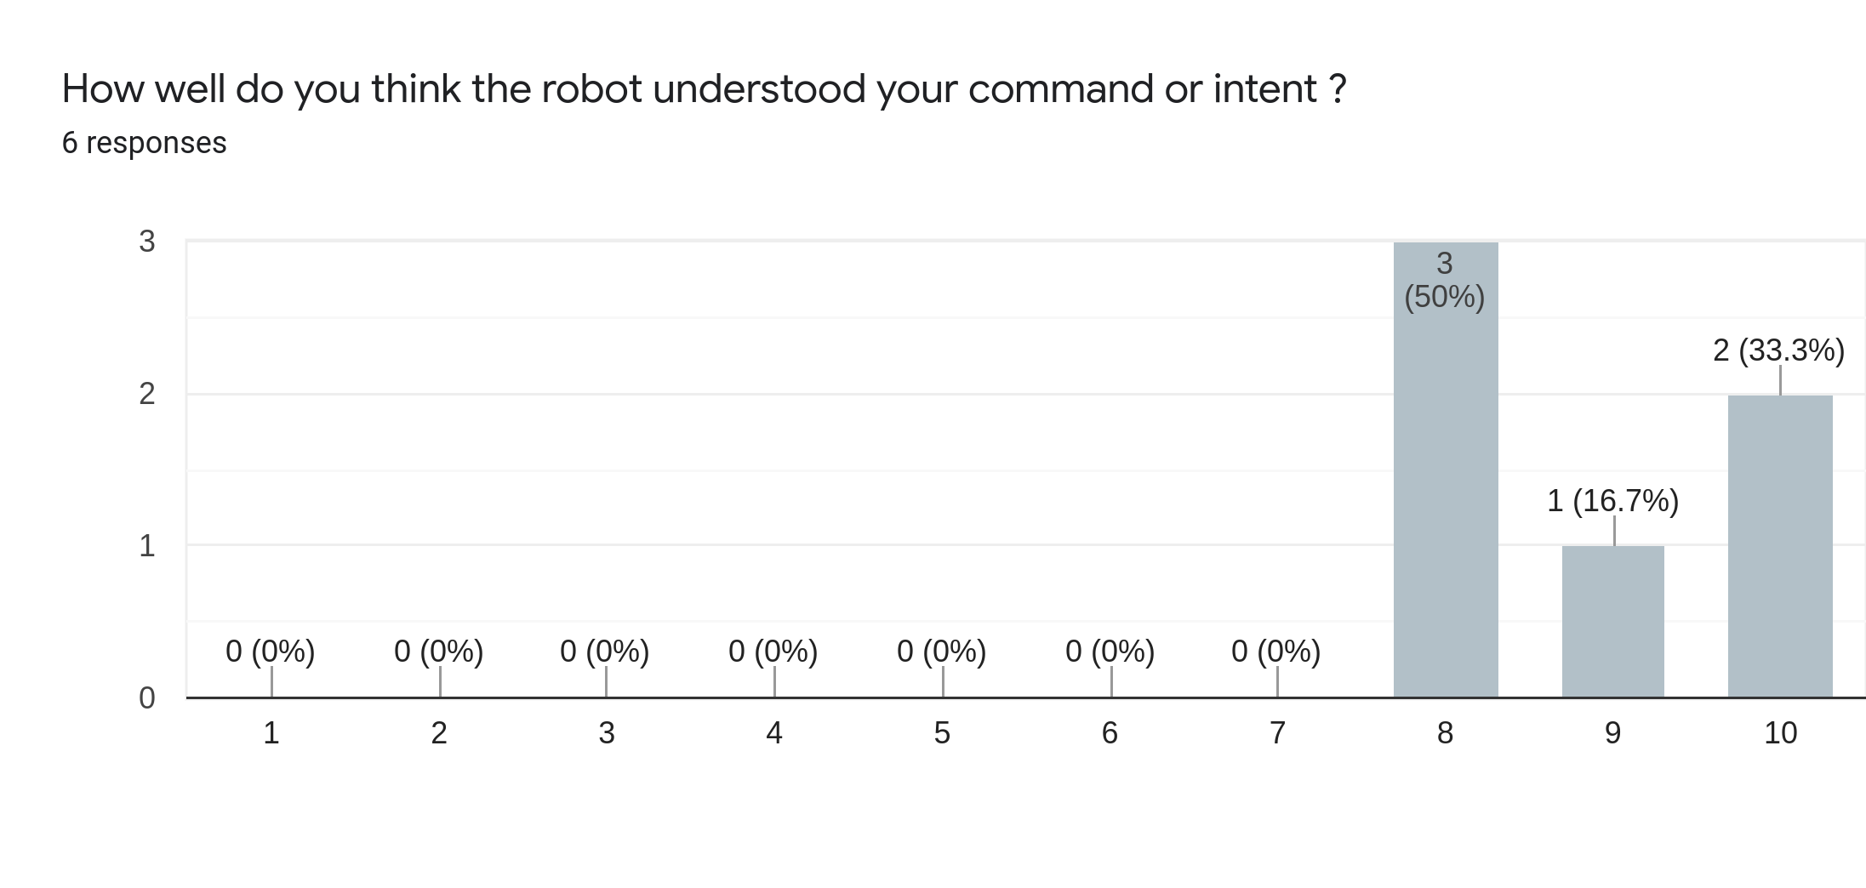
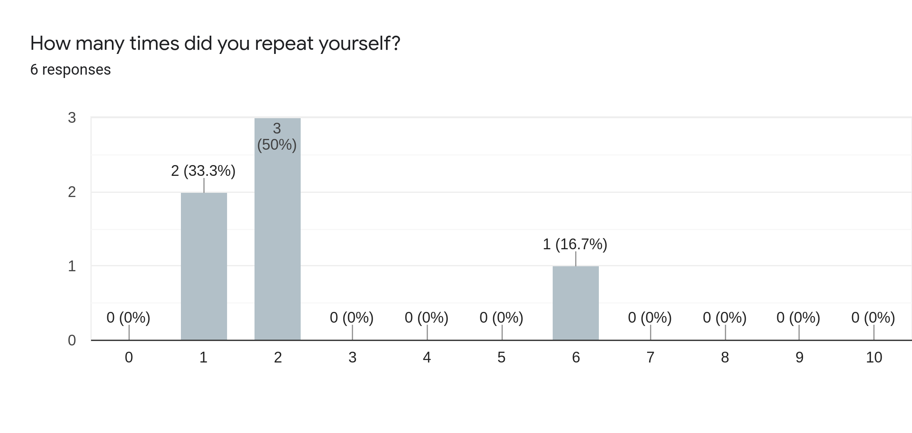
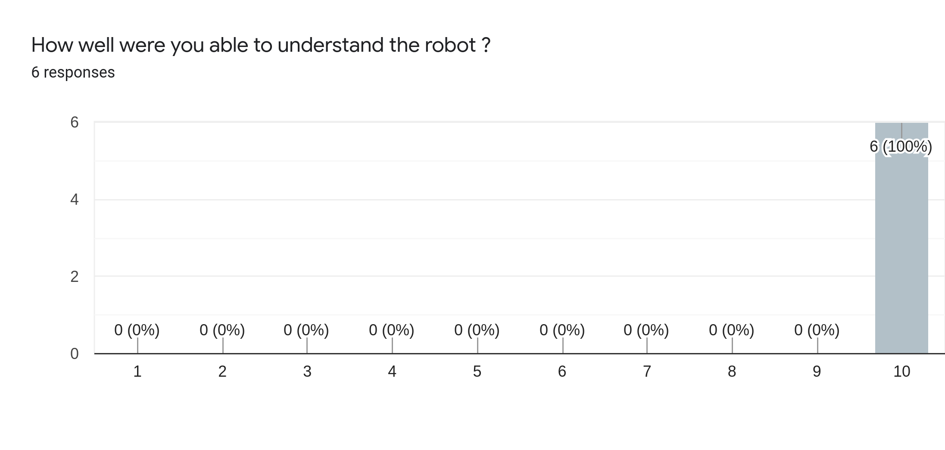
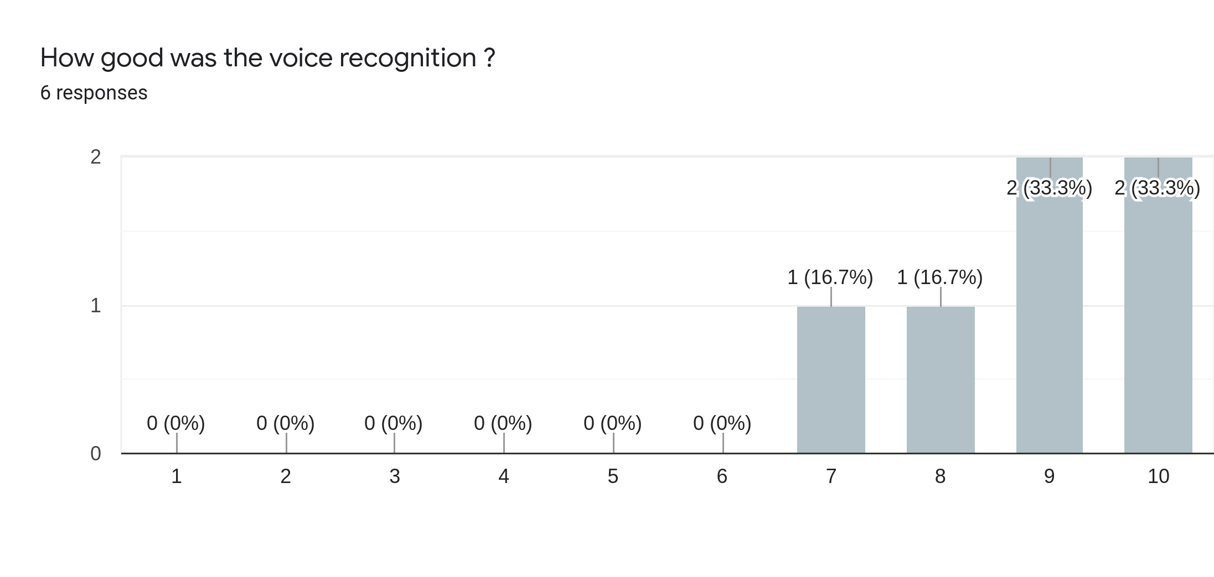
User Study
Notes:
Denny

Slide 23
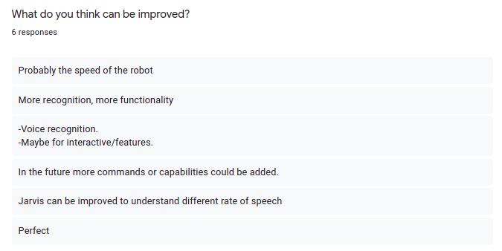
User Study
Notes:
Denny

Slide 24
Progress of the Project
Speech to audio file. Audio to text.
Semantic Analysis: Understanding the intent of the spoken sentence
Working towards Extended Goals and User Survey
Speech Recognition
SUCCESS !
Command Data
Data-set of Command formation (survey) and Analysis of the sentences.
Integrating with ROS and Unity to make the robot perform the task/command.
Notes:
Nihal

Slide 25
Objectives of Learning
Knowledge Learning | Skill Learning
Basic concepts of ROS and Unity | Integrating ROS with Unity
Understanding working of NLP | Semantic analysis of natural language
Analysing different methods of speech synthesis | Develop a speech synthesis module
Navigation stack | Implement navigation stack for our robot
Understand various metrics collection methods

Slide 26
Deliverables
Baseline:
Robot detecting speech via a trigger word/phrase.
Task:
Taking an object from A to B.
Taking an object from current location to goal location. (Guiding and Drop-off).
HRI:
Understand conversational task. (Can you please show me the way to room 3?)
Clear Ambiguity in Task. (Asks for clear instructions)
Have Basic Conversation. (How was your day?)
Stretched Goal:
More Engaging Conversation. (Maintain a decent conversation)
Work with cases of multiple speech recognition and Noisy Environment.
Obstacle Avoidance / Dynamic Environment.

Slide 27
Deliverables Achieved
Baseline:
Robot detecting speech via a trigger word/phrase.
Task:
Taking an object from rooms A to B.
Taking an object from rooms A to B and C.
Taking an object from current location to goal location. (Guiding and Drop-off).
HRI:
Understand conversational task. (Can you please show me the way to room 3?)
Clear Ambiguity in Task. (Asks for clear instructions)
Have Basic Conversation. (How was your day?)
Stretched Goal:
More Engaging Conversation. (Maintain a decent conversation)
Work with cases of multiple speech recognition and Noisy Environment.
Obstacle Avoidance / Dynamic Environment.

Slide 28
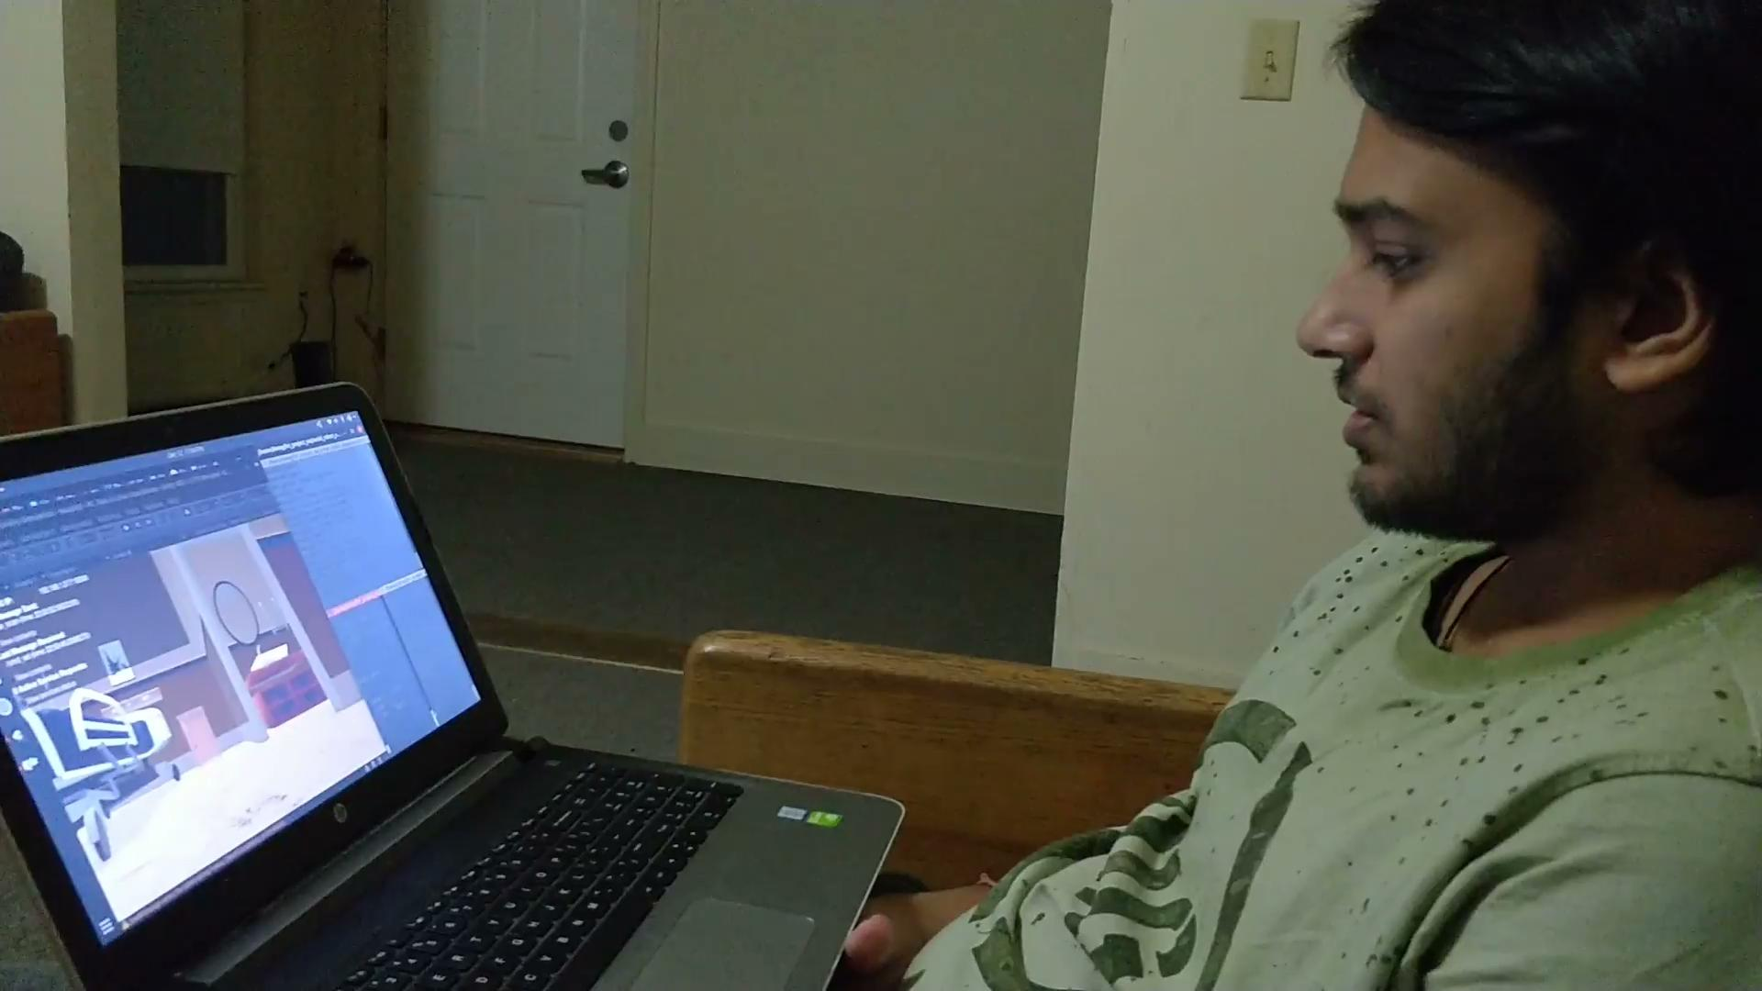
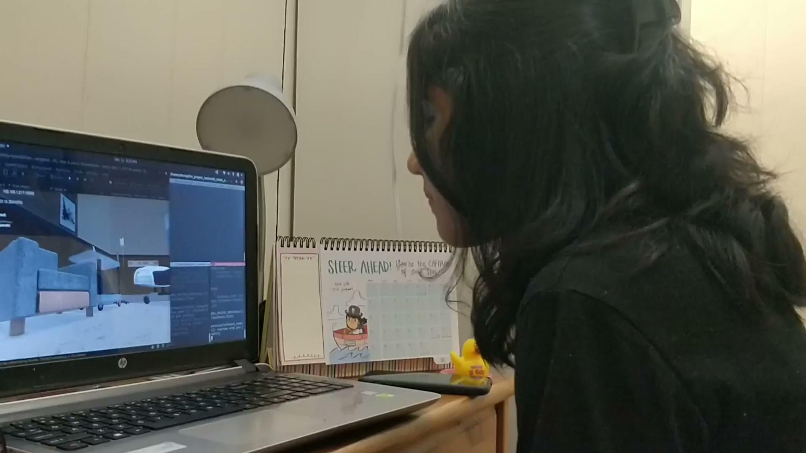
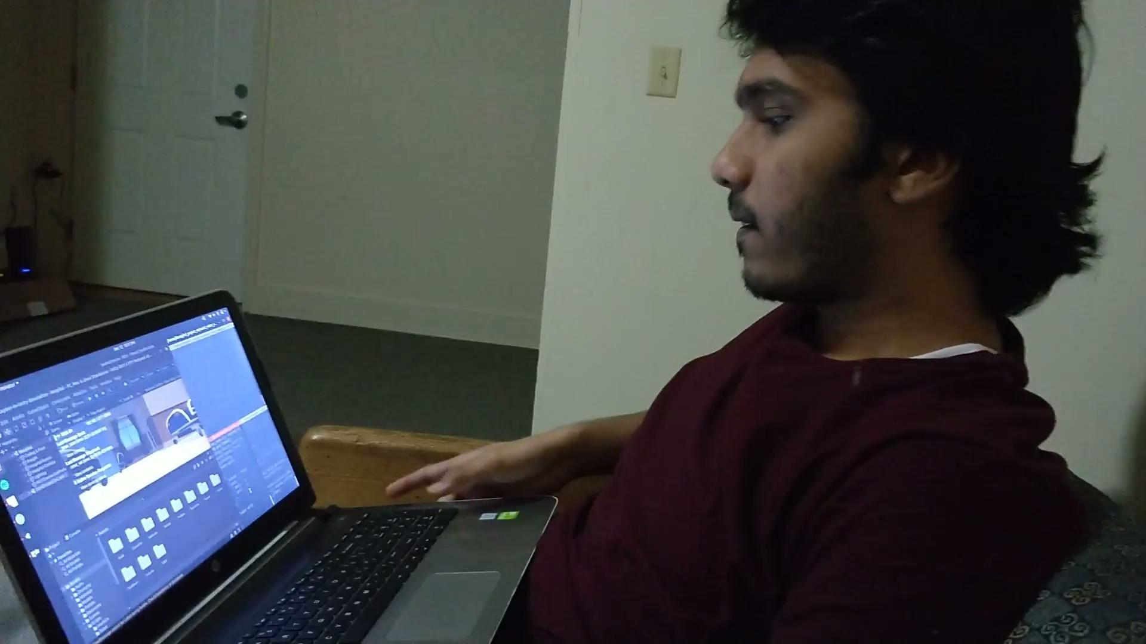
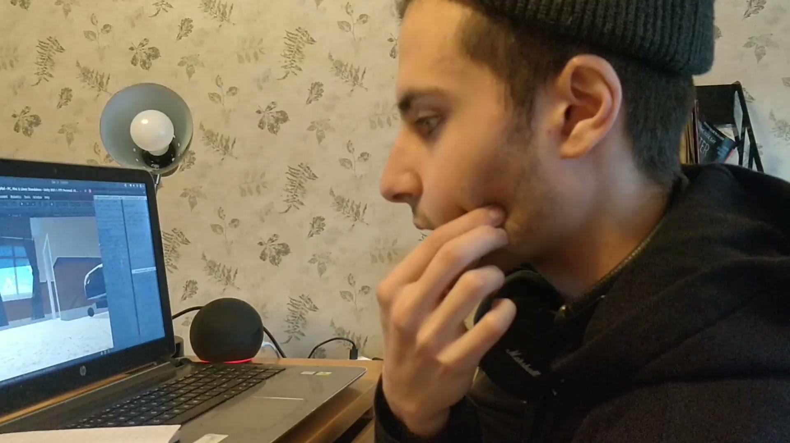
Demo
Link: https://drive.google.com/drive/folders/14saLGhgnFf94iduA1Lh-W2hBCulZIk1z?usp=sharing

Slide 29


The Team
DENNY BOBY
NIHAL SUNEEL NAVALE

Slide 30
Task Division
WEEKS | DENNY BOBY | NIHAL NAVALE
Week 1 - 2 | Literature Review Project Proposal PPT Setup Simulation | Literature Review Project Proposal PPT Familiarize with ROS Setup Simulation
Week 3 - 4 | Navigation code for point A to B in simulation. | Automatic speech recognition code.
Week 5 - 7 | Implement static parser for the detected speech Implement semantic analysis module for post processing
Week 8 | Combine speech command with navigation
Week 9 | Testing the entire system
Week 10 | Metrics collection
Week 11 | Buffer
Week 12 | Achieve extended goal
Week 13 | Report | PPT
Week 14 | Presentation

Slide 31
Q & A

